Slide 1
FINAL YEAR PROJECT PRESENTATION
TITLE: PYTHON BASED SIGNALS AND FUNCTIONS ANALYZER USING GRAPHICAL USER INTERFACE
TEAM: GEDEON MUHAWENAYO
HIRWA HENRY CHRISTIAN
MUTESI SYLVIA
SUPERVISOR: HITIYISE EMMANUEL
18th July 2019

Slide 2
INTRODUCTION AND PROJECT BACKGROUND
Rwanda and other African countries are advancing in science and technology, due to this reason studying and understanding well the science theories and principles is very critical. Science and technology are very essential in our daily life using them we can solve most of the social issues. Therefore, better understanding of science and engineering principles is the key.
Most of the times people learn theory without getting the knowledge about the system behavior and characteristics of the signal and functions. So our project called python based function analysis will be able to plot most functions (functions with not more than three variables) which will help academic students to know the systems’ behavior and also the analysis will be real time so that it becomes more understandable compared to the past years.

Slide 3
ABSTRACT
Python is a powerful programming language for handling engineering and scientific computational tasks efficiently [1]. It offers an extremely wide selection of tools for tasks such as scientific computing, signal processing, Web site construction, database programming, and graphical user interface (GUI) design. The language is platform independent with most programs running on Linux, Microsoft Windows, or MAC OS virtually unchanged [2]. In signal and functions analysis, python can be used for real time analysis and plot of signals. These days people mainly students in the engineering field have problem of poor understanding of signals and functions behaviors because they use methods that dont provide away to interact with them. As a solution, exploiting the power of python programming language, we have designed a graphical user interface to be used for real time plotting of signals and functions as well, this would be a better way of providing good understanding of signals behavior so the special things in our project it is possible to acquire input signal from any circuit to see all the parameters related to it. We have made an executable file that could be shared and installed in windows computer, since every student can afford to have his/her own computer.

Slide 4
PROJECT OBJECTIVES
The main objective of our project is to build a functional and signal analyzer user interface, and to provide executable file for widows computer.
Other objectives:
To build an interactive UI
To learn python as a tool of engineering students

Slide 5
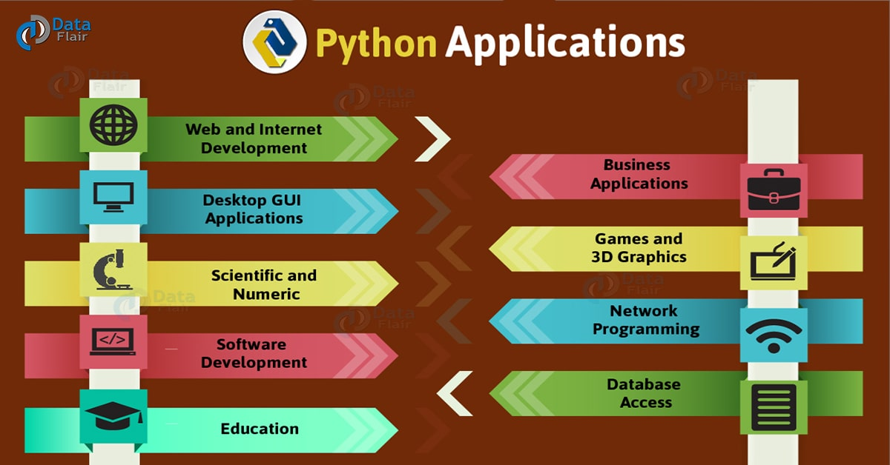
THEORIES REGARDING OUR PROJECT
PYTHON: is a high-level, interpreted and general-purpose dynamic programming language that focuses on code readability, it is;
Interactive
Interpreted
Modular
Dynamic
Object-oriented
Portable
High level
Extensible in C++ & C

Slide 6
RESEARCH METHODOLOGY
methods and technics that are being used to gather information;
Library books,
IEEE journals and
Exchanging idea with supervisor and colleagues.

Slide 7
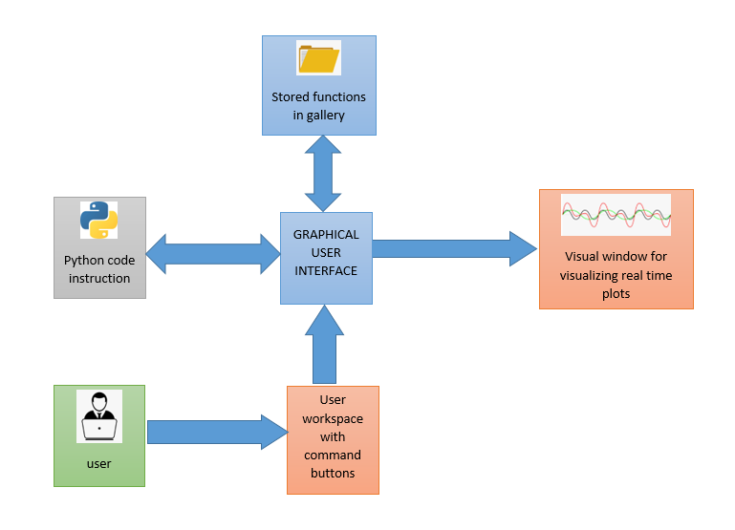
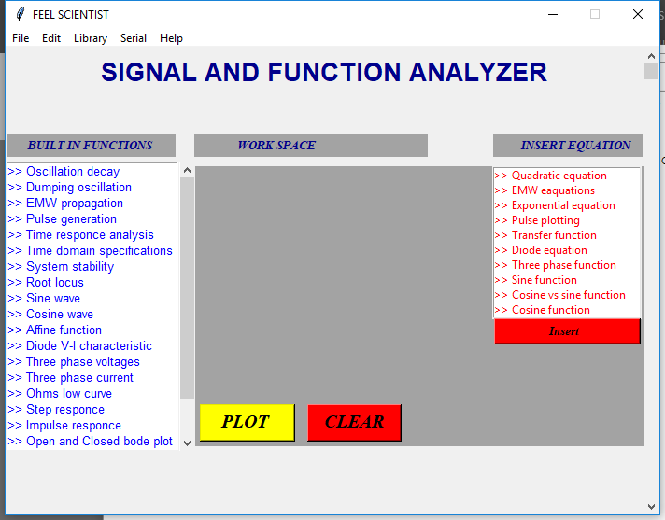
USER INTERFACE DEVELOPMENT
SYSTEM BLOCK DIAGRAM
DEVELOPED USER INTERFACE

Slide 8
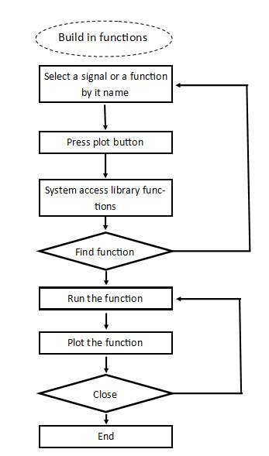
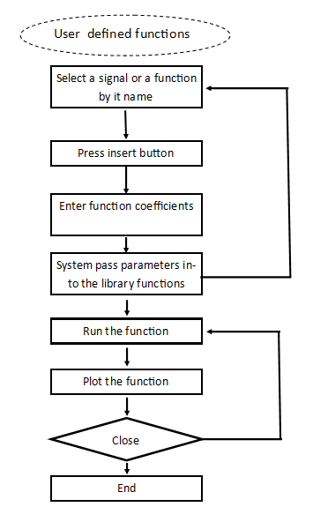
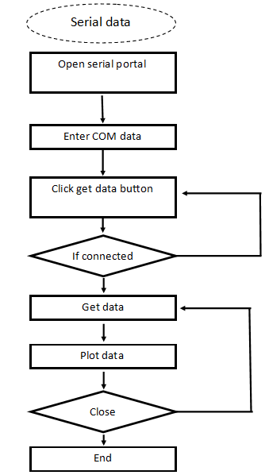
LOGIC BEHIND THE SYSTEM

Slide 9
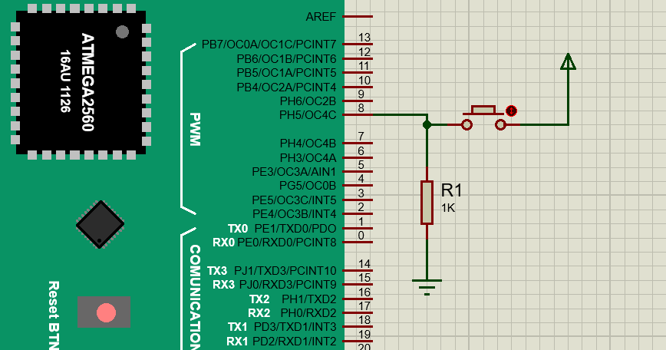
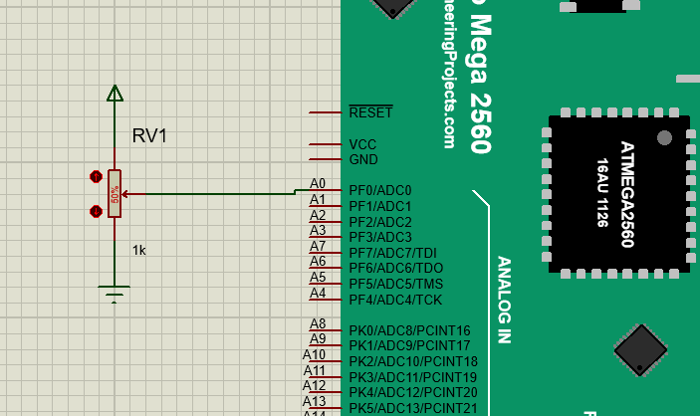
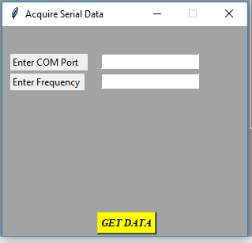
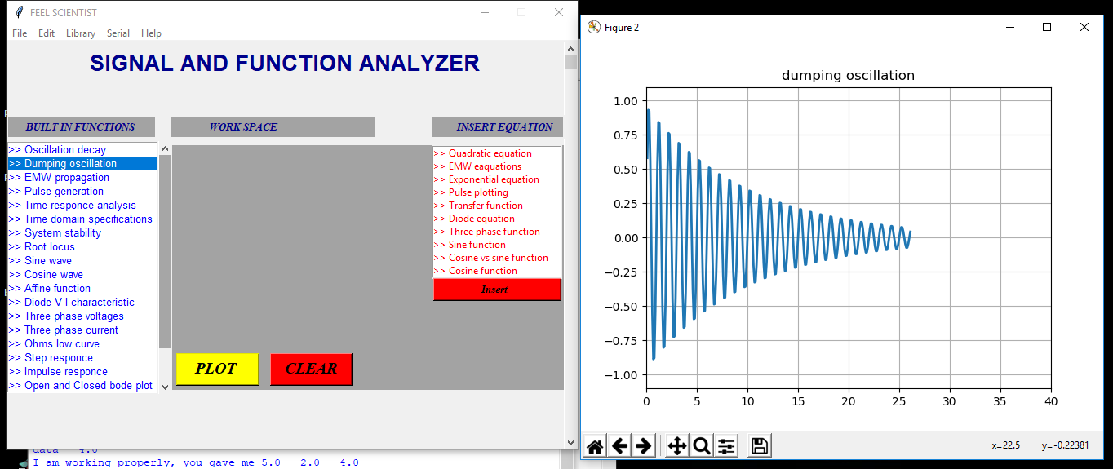
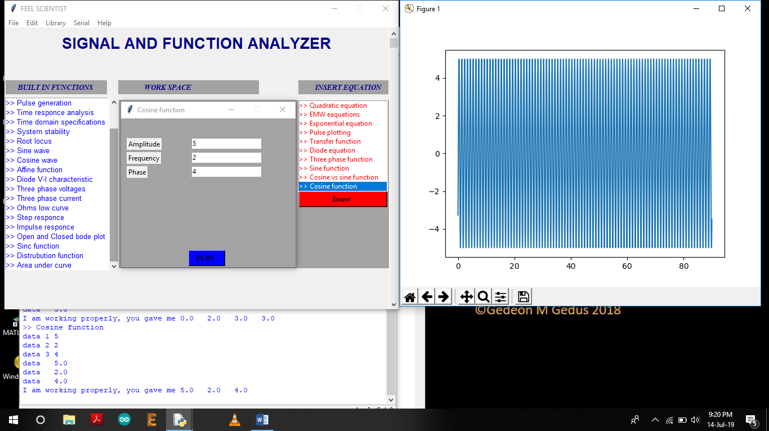
SYSTEM DEMONSTRATION
ANALOG SIGNAL
SERIAL DATA
DIGITAL SIGNAL
BUILT IN FUNCTIONS
USER DEFINED FUNCTIONS

Slide 10
FUTURE SCOPE OF THE PROJECT
Provide functions for all built in and user defined functions
Make cross platform executable file
Customize the user interface so that user him self can add a library

Slide 11
CONCLUSION AND RECOMMENDATION
CONCLUSION
As conclusion we have successfully developed require UI, hence this project has achieved all its goals and objectives.
RECOMMENDATIONS
We commend that the system can be implemented everywhere mainly in engineering students to visualize the signals behavior and trends for more understanding we also made the system of acquiring the signal from the output of any circuit.

Slide 12
REFERENCE
Noyan, Kinayman, "python for microwave and RF engineers", IEEE microwave magazine IEEE, vol 12, no. 7, pp. 1-6, 2011.
Noyan Kinayman, "Parallel Programming with GPUs: Parallel Programming Using Graphics Processing Units with Numerical Examples for Microwave Engineering", Microwave Magazine IEEE, vol. 14, no. 4, pp. 102-115, 2013.
L. Bavoil, S. P. Callahan, P. J. Crossno, J. Freire, C. E. Scheidegger, C. T. Silva, and H. T. Vo. VisTrails: Enabling interactive multiple-view visualizations. Proceedings of IEEE Visualization, 2005.
Martelli, A., Ravenscroft, A. M., and Ascher, D., editors (2005). Python Cookbook. O'Reilly, Sebastopol,California, 2nd edition.
[online] https://medium.com/@mindfiresolutions.usa/advantages-and-disadvantages-of-python-programming-language-fd0b394f2121
Langtangen, H. P. (2005). Python Scripting for Computational Science, volume 3 of Texts in Computational Science and Engineering. Springer. ISBN 3540294155.
B. Uengtrakul, D. Bunnjaweht, "A Block Diagram Programming System for Interactive DSP Simulation", Proceeding of the 11th International Conference on Electrical Engineering and Electronics Computer Telecommunications and Information Technology Proc. 11th IEEE ECTI, pp. 1-6, 14–17, may 2014.
T. E. Oliphant. Python for scientific computing. Computing in Science and Engineering, 9:10–20,2007.
T.Zachariah et al.“The Internet of Things Has a Gateway Problem Categories and Subject Descriptors,” University of Michigan, pp. 3–4, 2015.
J. C. Alexa Huth, “The Basics of Cloud Computing,” United States Computer Emergency Readiness Team, pp. 123–149, 2014.
Roushan, T. and Chaki, D. et al. (2013), University course advising: Overcoming the challenges using decision support system, in Computer and Information Technology (ICCIT),16th International Conference on, 2014, p. 13-18.
De Silva, Clarence W. Vibration and Shock Handbook, CRC Press, 2005, p. 16-63 Lecklider, Tom; Evaluation Engineering, October 2011, accessed October 10, 2011
K. P. Moran, C. Bernal-Cárdenas, M. Curcio, R. Bonett and D. Poshyvanyk, "Machine Learning-Based Prototyping of Graphical User Interfaces for Mobile Apps," in IEEE Transactions on Software Engineering.
K. P. Moran, C. Bernal-Cárdenas, M. Curcio, R. Bonett and D. Poshyvanyk, "Machine Learning-Based Prototyping of Graphical User Interfaces for Mobile Apps," in IEEE Transactions on Software Engineering.
Piotrowski Przemyslaw Build a Rapid Web Development Environment for Python Server Pages and Oracle / Przemyslaw Piotrowski // Oracle Technology Network. – Oracle. –2012.
Roushan, T. and Chaki, D. et al. (2013), University course advising: Overcoming the challenges using decision support system, in Computer and Information Technology (ICCIT),16th International Conference on, 2014, p. 13-18.

